Slide 1



Individual ASSIGNMENT
TU’s E-Bookstore
CT043-3-1-IDB
INTRODUCTION TO DATABASES
INTAKE CODE:NP1F2301IT
Atul Dhital
NP069586

Slide 2
Introduction to Database
A database is an organized collection of structured information, or data, typically stored electronically in a computer system. A database is usually controlled by a database management system (DBMS). Together, the data and the DBMS, along with the applications that are associated with them, are referred as a database system, often shortened to just database.
Data within the most common types of databases in operation today is typically modeled in rows and columns in a series of tables to make processing and data querying efficient. The data can then be easily accessed, managed, modified, updated, controlled, and organized. Most databases use structured query language (SQL) for writing and querying data.

Slide 3
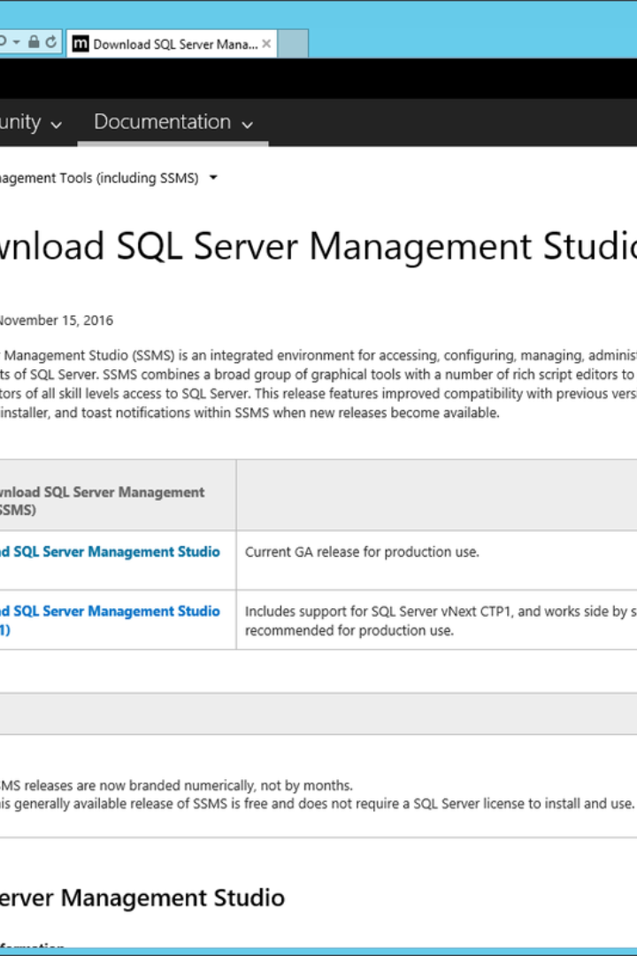
What is DDL and DML?
DDL (Data Definition Language) and DML (Data Manipulation Language) are subsets of SQL, the standard language for interacting with relational databases. DDL is used to define the database schema, while DML is used to manage data within the database.

Slide 4
Importance of DDL and DML in Database Management
Database Structure
DDL is crucial for creating, modifying, and deleting the structure of a database, including tables, indexes, and constraints.
Data Operations
DML plays a vital role in querying, inserting, updating, and deleting data records within the database, ensuring data integrity and accuracy.

Slide 5
About the Database Assignments
The Assignments database is a structured collection of tables designed to manage various aspects of a E- library. It encompasses a wide range of functionalities, from user management and profile handling to book inventory, shopping cart operations, order processing, and reviews. This comprehensive system serves as the backbone for maintaining an efficient and user-friendly service for both staff and members.

Slide 6
User Management System
User Registration
Users are registered with unique identifiers, usernames, and passwords, categorized as either staff or members.
Profile Creation
User profiles are created with personal details such as names, addresses, and contact information, linked to the Users table via UserID.
Security
Passwords are stored securely to protect user accounts and maintain privacy.
Add to cart option
We also have add to cart option

Slide 7
Business Rules
Registering as a library member requires acceptable identification and contact information.
Members receive a unique library card number upon registration.
Members must provide a valid library card to borrow books. Members can borrow up to five books at a time.
The borrowing duration is two weeks, with the opportunity to renew for another two weeks if no holds are found on the book.
To avoid late fines, return books by the due date.
Members with overdue books cannot borrow new goods until they are returned. Members can reserve books that are already checked out by other members.

Slide 8
Books Inventory
Title
Author
Genre
Price
Availability
Stock
Dune
Frank Herbert
Science Fiction
3976.12
Available
15
Frankenstein
Mary Shelley
Horror
1987.40
Available
20
Pride and Prejudice
Jane Austen
Romantic
1657.27
Available
25

Slide 9
Shopping Cart and Orders
Shopping Cart
Order Processing
Order Updates
Users can add books to their shopping cart, specifying the quantity and viewing the total price for their selections.
Orders are placed with details such as user ID, book ID, order date, and total amount, with a status indicating payment completion.
Orders are updated with quantities and recalculated total amounts to reflect the current state of the user's purchase.

Slide 10
Reviews and Ratings
1
User Feedback
2
Rating System
Users provide valuable feedback on books with ratings and reviews, contributing to the community's knowledge base.
Books are rated on a scale from 1- 10, allowing users to express their satisfaction level.
3
Review Insights
Textual reviews offer in-depth insights and personal experiences from the reader’s perspectives.

Slide 11



Warehouse and Deliveries
Stock Reception
Warehouse receives quantities of books linked to orders, ensuring inventory levels are maintained.
Delivery Management
Orders are managed for delivery with statuses such as 'Delivered', 'Pending', or 'In Transit'.
Status Updates
Delivery statuses are updated to keep track of the order's journey to the customer.

Slide 12
Publisher Partnerships
Publisher Details
Collaboration
Publishers are cataloged with contact information, ensuring a smooth supply chain for books.
Close collaboration with publishers allows for a diverse and well-stocked library.
Communication
Efficient communication channels are established with publishers for order fulfillment and inventory updates.

Slide 13
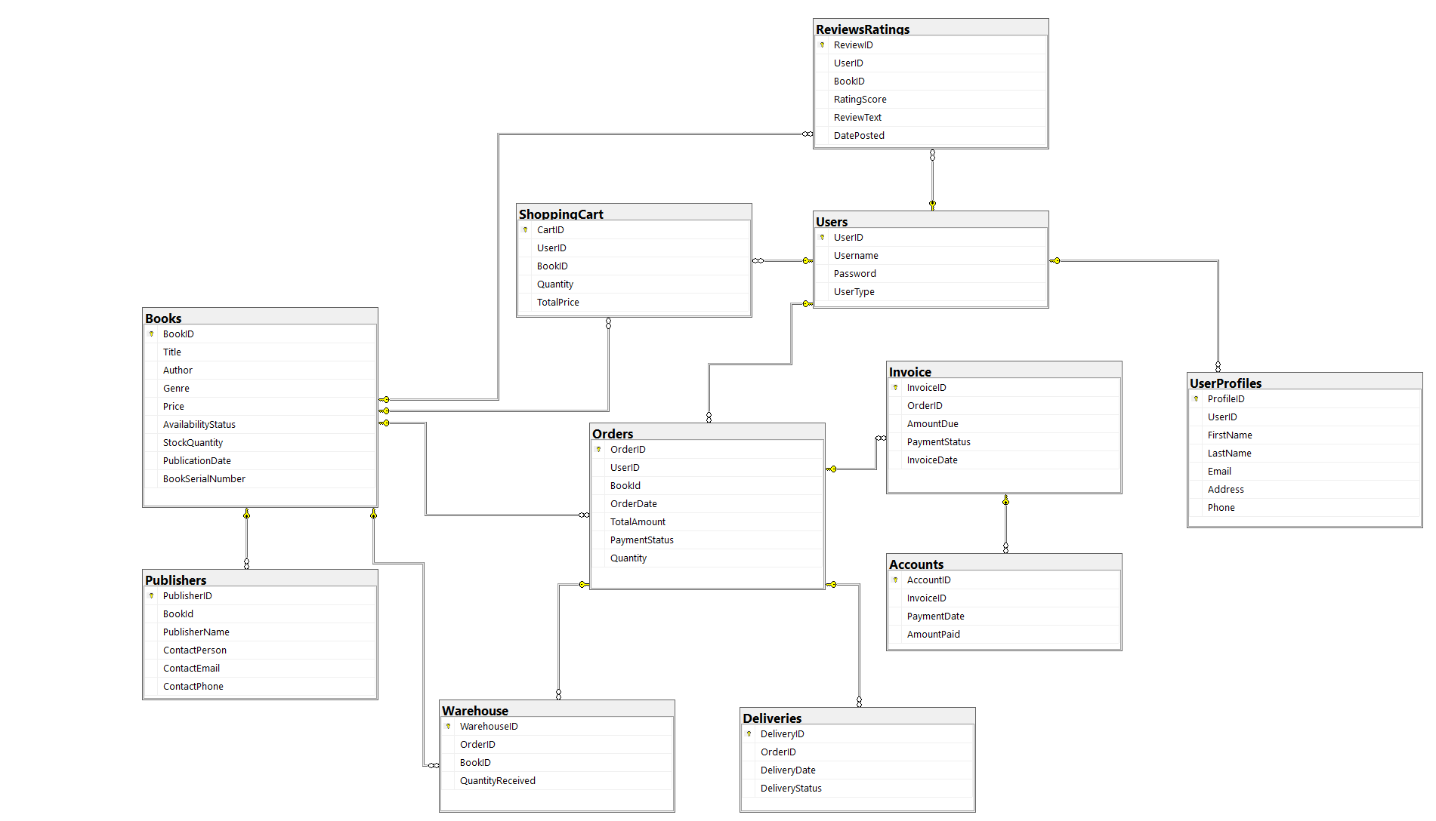
Database Diagram:

Slide 14
Thank you

